Slide 1
"Digital Media Primer" Yue-Ling Wong,
Copyright (c)2013 by Pearson Education, Inc. All rights reserved.

Slide 2
Chapter 5
Capturing and Editing Digital Audio
Part 1
Recording Digital Audio

Slide 3
In this lecture, you will learn:
the general hardware and software requirements for recording a digital audio
the general steps to record a digital audio

Slide 4
Ways to Acquire Digital Audio
Record
Digitize analog medium

Slide 5
Recording Requirements
Hardware
Software

Slide 6
Recording:
Hardware Requirements
Computer with a sound card
  Almost all computers nowadays are equipped with a sound card.
  Sound card: converts the electrical signals into digital format through sampling and quantization of the signals
Microphone
  built-in the laptop
  Usually does not produce sufficient sound quality
  external microphone

Slide 7
Microphones
Unidirectional
  Most sensitive to sound coming from the front
  Advantage: Ignore noise coming from the rear
Omnidirectional
  Sensitive to sound coming from all directions

Slide 8
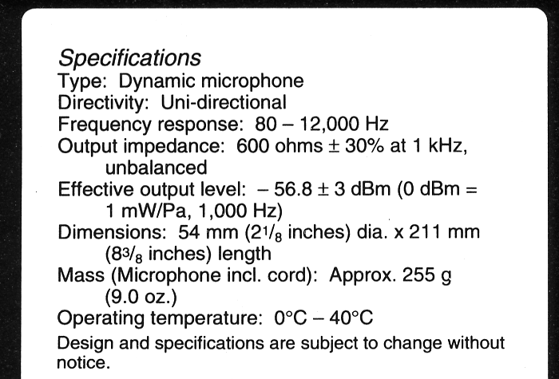
Example Label of a Microphone

Slide 9
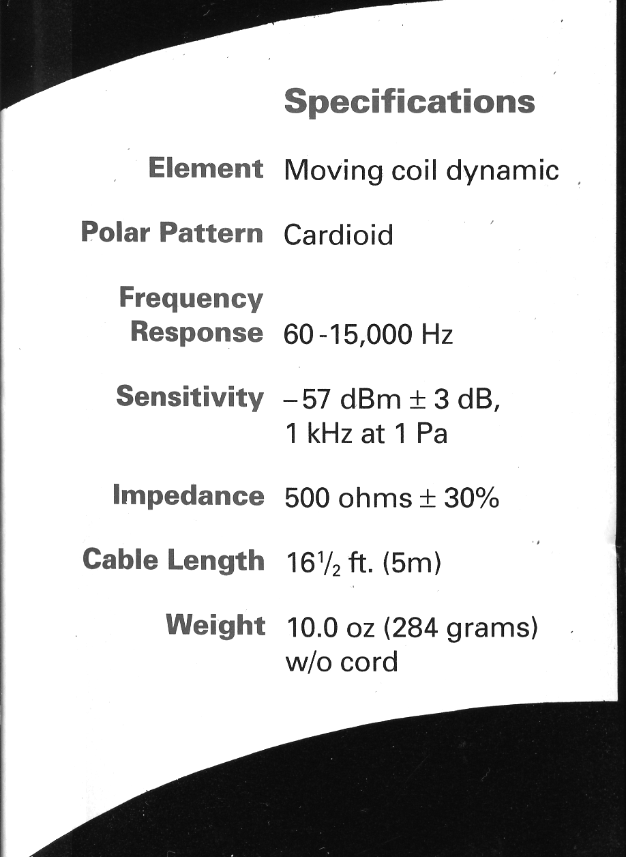
Example Label of a Microphone
means unidirectional

Slide 10
If you don't have the specifications of a microphone...
General Rule: Place the sound source directly in front of the microphone

Slide 11
Recording:
Software Requirements
Digital audio recording program
Also lets you edit audio
Some common programs:
  Adobe Audition
  Sony Sound Forge
  Audacity (free, open-source)

Slide 12
General Steps For Recording With a Digital Audio Program
Start a new file
Specify settings:
  sampling rate
  bit depth
  number of channels
If possible,
  run through or reherse the audio you want to record while observing the sound input level
  adjust the sound input level so it stays below the red area for the whole audio run-through
Hit the record button to start recording, stop button to stop

Slide 13
Sampling Rate Setting
Sampling rate examples:
  44,100 Hz: CD Quality
  22,050 Hz: Sufficient for multimedia projects with voice over and loop musics

Slide 14
Bit Depth Setting
8-bit
  usually sufficient for speech
  in general, too low for music
16-bit
  for music

Slide 15
Number of Channels Setting
1: mono
2: stereo

Slide 16
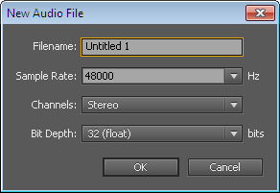
New File Dialog in
Adobe Audition

Slide 17
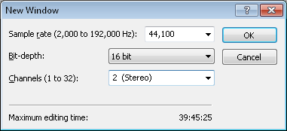
New File Dialog in
Sony Sound Forge

Slide 18
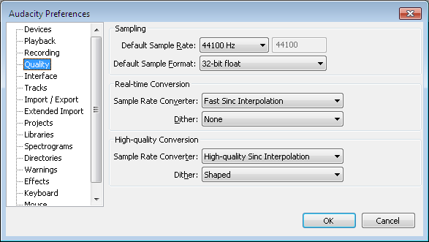
Preferences Dialog in
Audacity

Slide 19
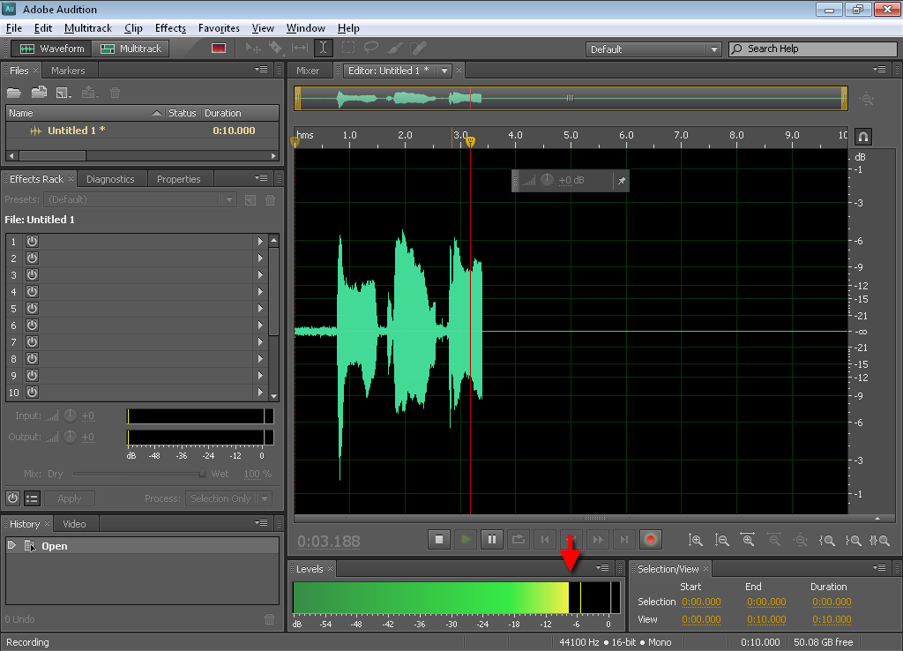
Audio Level Meter in
Adobe Audition

Slide 20
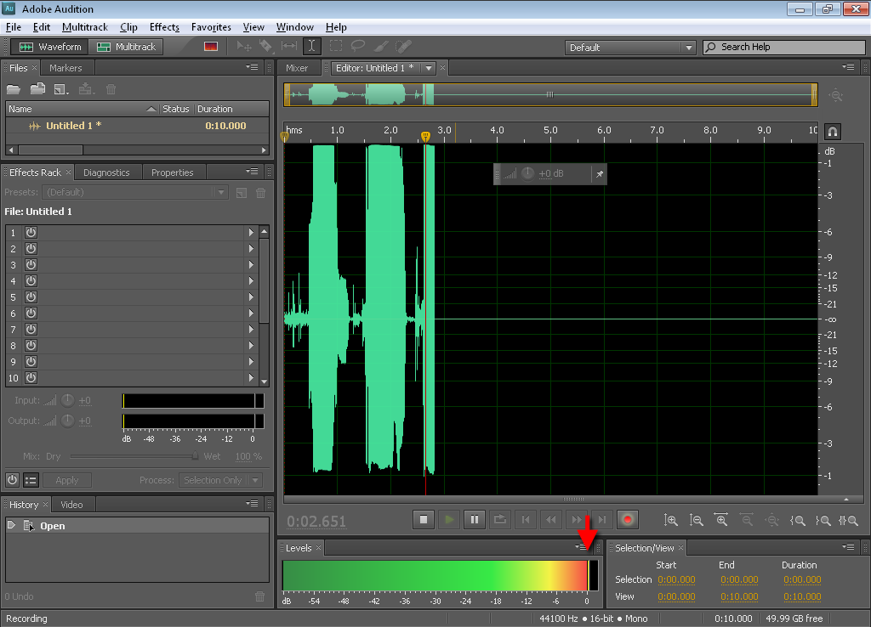
Audio Level Meter in
Adobe Audition
Clipping occurs!
Clipping causes distortion.
Too high!

Slide 21
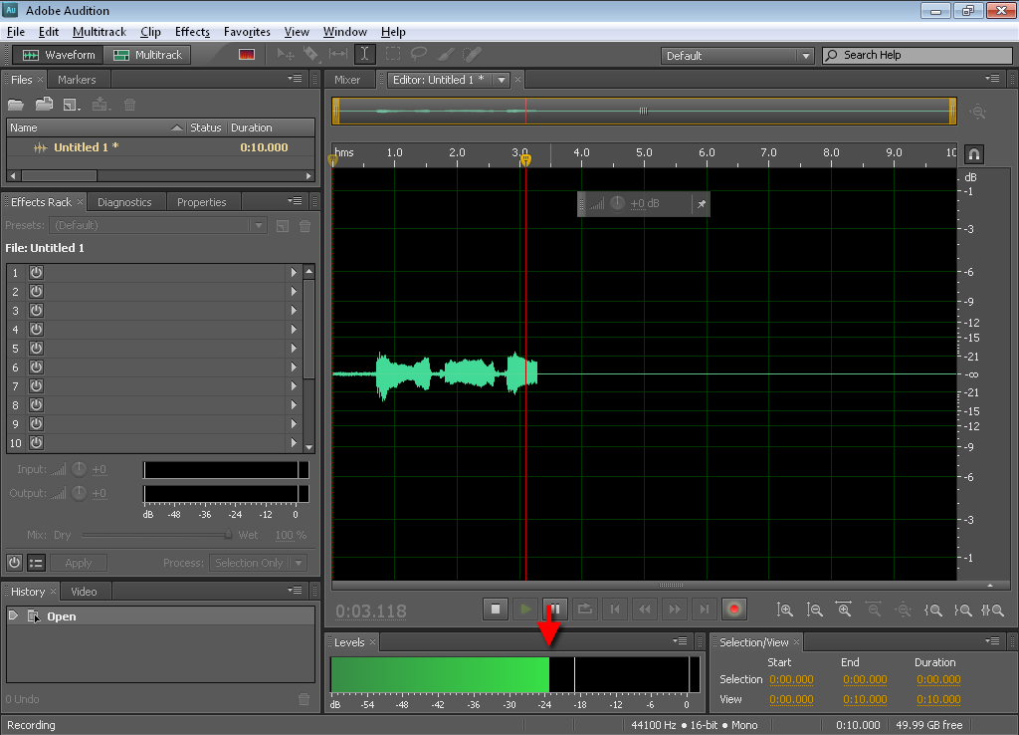
Audio Level Meter in
Adobe Audition
Recorded sound will be too soft!
Too low!

Slide 22
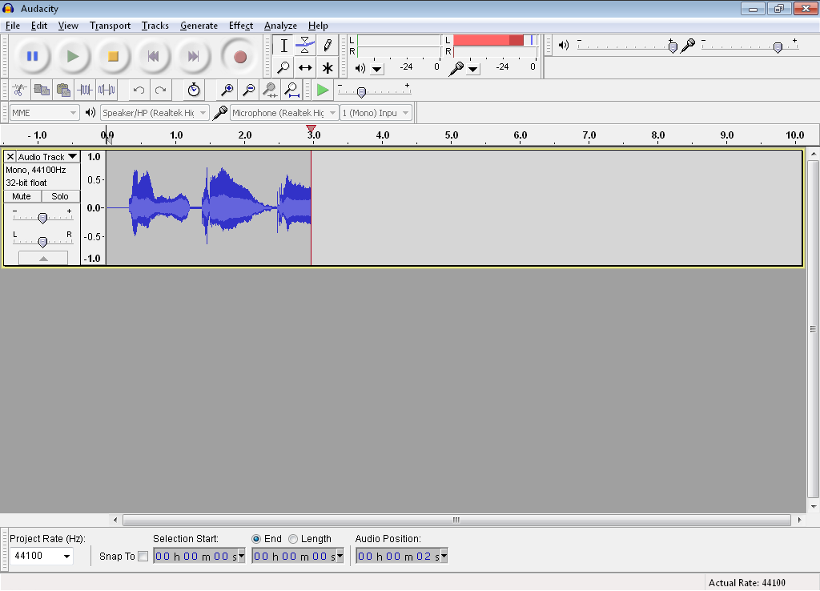
Audio Level Meter in
Audacity
Input volume slider
Input level meter

Slide 23
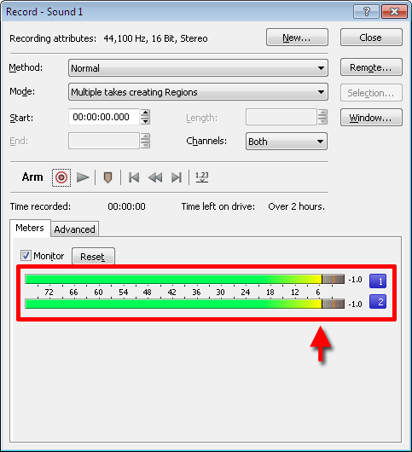
Audio Level Meter in
Sony Sound Forge

Slide 24
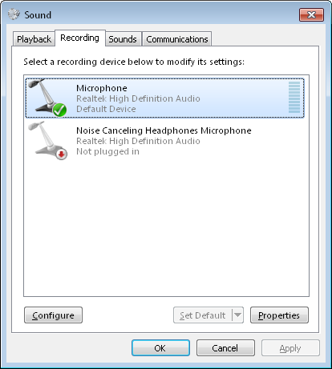
Microphone Level Adjustment in Windows 7

Slide 25
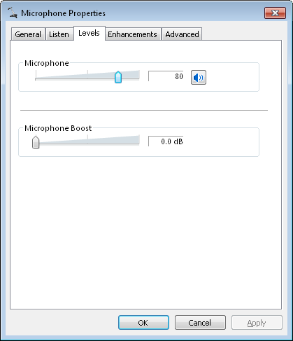
Microphone Level Adjustment in Windows 7

Slide 26
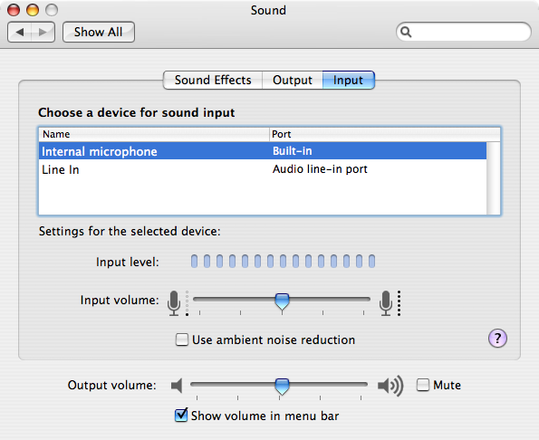
Microphone Level Adjustment in Mac OS X

Slide 27
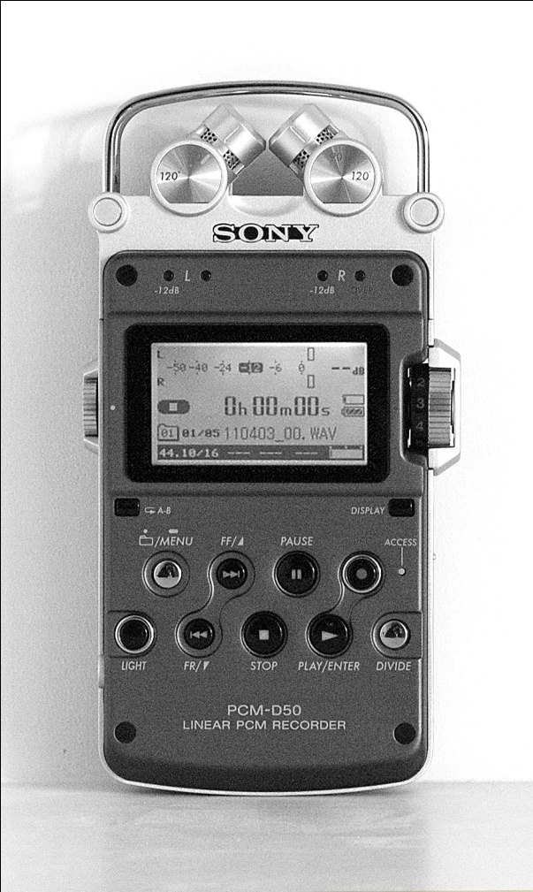
Field/Outdoor Recording
Handheld recorders:
  Zoom H4n, Sony PCM-D50
  High quality stereo recording
  Recorded to internal memory or memory card
  Also support USB transfer to computer
  Audio level meter
  File format: WAV and MP3

Slide 28
Field/Outdoor Recording
Voice recorder apps on cell phones:
  Not intended for high quality audio
  Usually mono
  File format: Lossy compression to produce smaller file size suitable for email and uploading to Web from the phone
  To transfer the audio to computer:
    Common method: Email it to yourself as attachment and check your emails on your computer to detach the file
    iPhone: Can also use iTunes
    Android phones: Connect the phone to your computer as a drive

Slide 29
Digitizing Analog Medium
such as cassette tapes

Slide 30
Digitizing Analog Medium
Connect the line-out port of your analog medium playback device to the line-in port on your computer
Rehearse the playback of the analog medium to determine the best input level
Start recording using digital audio recording program before start playing the analog medium

Slide 31
Review Questions
Note to instructor:
Depending on your preference, you may want to go over the review questions at the end of this lecture as an instant review or at the beginning of next lecture to refresh students' memory of this lecture.

Slide 32
Review Question
True/False: The optimal meter level for recording is going past the red area of the meter.
Notes:
False

Slide 33
Review Question
Which type of microphone is most sensitive to the sound coming from the front?
undirectional
omnidirectional
Notes:
A

Slide 34
Review Question
If you do not know the directional property of a microphone, as a general rule where do you place the sound source relative to the microphone?
Notes:
in front of the microphone

Slide 35
Review Question
Why is it important to watch out for the input level meter during recording?
Notes:
if the level is too high, clipping will occur causing distortion. If the level is too low, the recorded audio will be too soft.

